Slide 1
What kind of schools do we want for our kids?
Families Leading Change
West Virginia Healthy Kids and Families Coalition

Slide 2
What is Families Leading Change?
A Family-led Statewide Grassroots Movement to Improve Education in Our Local Communities and at the State Level.

Slide 3
Our Goals
Creating a Broad Statewide Team
Lifting Up a Menu of the Great Things Already Happening Across the State
Training Parents on Leadership Skills and the Education System
Conducting a Mini-Grant Process

Slide 4
How do I…
Run for School Board
Help Create An Entrepreneurial School
Recommend Alternatives to Discipline
Start a Circle of Parents Group
Advocate for Community Schools
Support School Based Mental Health
Expand Breakfast and Lunch Programs

Slide 5
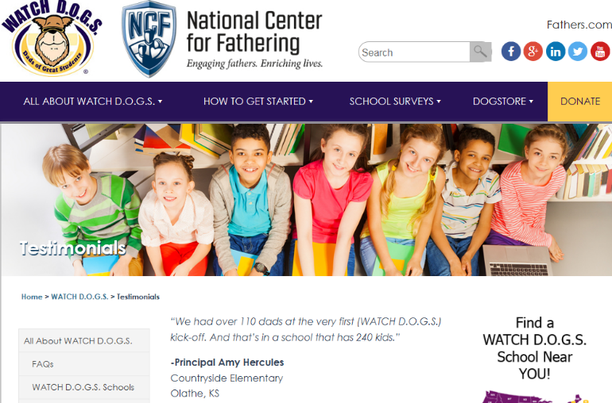
WATCH D.O.G.S.
WATCH D.O.G.S., a K-12 program, invites fathers, grandfathers, uncles, or other father figures to volunteer at least one day all day at their child’s/student’s school during the school year.

Slide 6
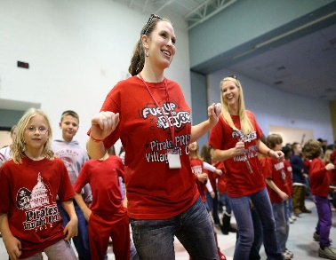
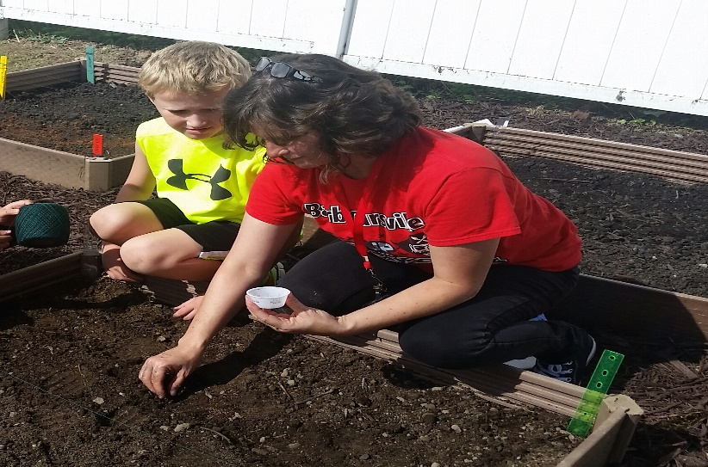
SCHOOL WELLNESS TEAM
Creating a strong school wellness team that includes parents and students will help to ensure that the school has an active strategy plan to implement wellness into the school environment.

Slide 7
OUTDOOR LEARNING CENTER
An outdoor learning center is a place for the children and the community to gather and engage in activities that promote healthy, wellness and positive caregiver/child experiences.

Slide 8
What’s already happening in your community?

Slide 9
Imagine you had $2,000

Slide 10
Families Leading Change Summit
September 22 and 23, 2017
Fairmont State University
Fun
Interactive
Family-Friendly
Free Children’s Activities

Slide 11
WV Healthy Kids and Families Coalition
Our Children Our Future
Try This WV
Parent Wellness Network
Families Leading Change
Young WV
WV Good Jobs Conference
Strong Mountain Communities
Healthy Bodies, Healthy Spirits
Candidate Training Academies

