Slide 1
President/Vice President Training: Leading your PTA

Slide 2
PTA Mission:
To make every child’s
potential a reality by engaging and empowering families and communities to advocate for all children.

Slide 3
Today we’ll talk about….
Your Role as PTA President:
Leading, representing your PTA, overseeing
finances, communicating with members
Planning Your Year:
Meetings, budget, overseeing standards of affiliation, and working with your board

Slide 4
Let’s look a little closer at your role as President

Slide 5
Your Role as PTA President:
Lead the PTA
Oversee financial and legal obligations
Preside over meetings
Represent the PTA
Foster partnerships, relationships
Communicate with your members

Slide 6
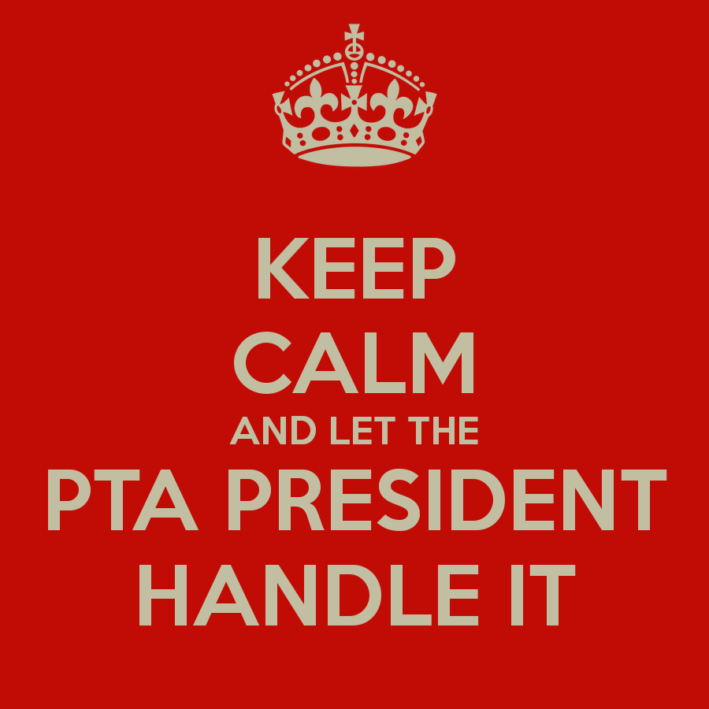
Be a good role model!
Always make ethical decisions and what is best for your PTA
Take “Board Basics” e-learning course on pta.org
Be professional and maintain confidential information when needed

Slide 7
Role of the President
Manage conflict and create unity
Conflict is a way of opening the door to new ideas and points of view.
It is an opportunity to explore new solutions to problems
It offers new approaches to cooperation, collaboration and communication
Discussion and disagreement takes place within the meeting
The final decisions of the board are voted upon and after the decision is made, show a united front.

Slide 8
Role of the President
Voice of the PTA
Always do what’s in the best interest of PTA
Never for personal gain
Members & Board Members shall not speak as official representative unless delegated to do so by the president
Always make it clear to someone if you are speaking as a parent/taxpayer….though unfortunately many will not understand or regard the distinction

Slide 9
Role of the President
Build positive relationships
Attend school board meetings and give an update of PTA in the public comments, email the board of events and success.
County Council: attend and share information.
Region: Ask other PTAs in your region what they have done, what works, etc.
Community business: reach out, invite them and thank them.
Media: again reach out, involve and thank.

Slide 10
Duties of the President
Preside over all meetings of the general membership and executive committee meetings
Delegate – the President does not do all the work on their own, you must delegate to be productive.
Serve as ex-officio over all committees except nominating and audit committees

Slide 11
Duties of the President
Prepare an agenda for meetings
Review minutes of previous meeting to determine any unfinished business
Contact all chairpersons to go over committee reports prior to meetings
Invite principal and teacher representatives to meetings
Get the date of the meeting out to the membership early.
Meet with executive board prior to the meeting
Come prepared to meeting and follow the agenda to stay on point

Slide 12
PTA VICE PRESIDENTS

Slide 13
Role of the Vice President
Chair committees as assigned by the President
Fill in for the President in meetings or as needed
Refer to bylaws for specific duties of the Vice President. Some PTA’s have more than one Vice President and each is responsible for a different role (membership, fundraising, etc.)

Slide 14
Planning Your Year
Set Your Goals – what do you want to accomplish this year?
Gather input from your members – what types of activities and programs are they interested in?
Decide what committees you will need to make these events happen.
Draft Your Budget – what money will you need to reach those
goals?
Set your Calendar – work with your Board and Principal
Maintain Standards of Affiliation – Remain in good standing with West Virginia PTA

Slide 15
What are the six items needed to be in good standing?

Slide 16
Units in Good Standing
New officer information (Local Unit Officer Form) sent to the State Office (completed online – www.westvirginiapta.org
Dues for at least 10 members paid by Oct. 1st
Bylaws (approved every 3 years)
Audit submitted to WV PTA (120 days after fiscal year)
990 submitted to WV PTA (30 days after submission to IRS)
General Liability and Bonding Insurance (annually)

Slide 17
Why are there standards of affiliation?
The requirements help ensure that PTAs stay on track
You are already required to perform most of these tasks by the IRS
They are designed for your protection
West Virginia PTA can help with record retention if you’re ever audited or items are needed by your school.

Slide 18
By being in good standing you receive
Affiliation with West Virginia PTA and National PTA
All West Virginia PTA and National PTA Resources
Participate in Programs such as Reflections and Student Healthy Recipe Challenge
Eligibility for grants and awards
The West Virginia PTA Bulletin and National PTA's Our Children
Nonprofit tax exemption
Sending voting delegates to convention
Exemption from West Virginia Sales Tax

Slide 19
Your State PTA Resources & Info.
Board of Managers
Local Unit Binders
WV PTA Bulletin
Leadership training
Annual Convention
WV PTA Website www.westvirginiapta.org
National PTA Website and E-Learning Courses

Slide 20
Main Goals to Achieve:
Plan! (Programs, Projects, Budget and Membership)
Organize Fundraising to Reach Goals
Effectively Communicate with Your Members

Slide 21
What is one of the most important things to remember about being a good leader?

Slide 22
Having good communication
and the ability to unite your members

Slide 23
What are some ideas to unite your members and
local units?

Slide 24
What is the secret to making your job as President run as smoothly as possible?

